Slide 1
Excel 2016

Slide 2
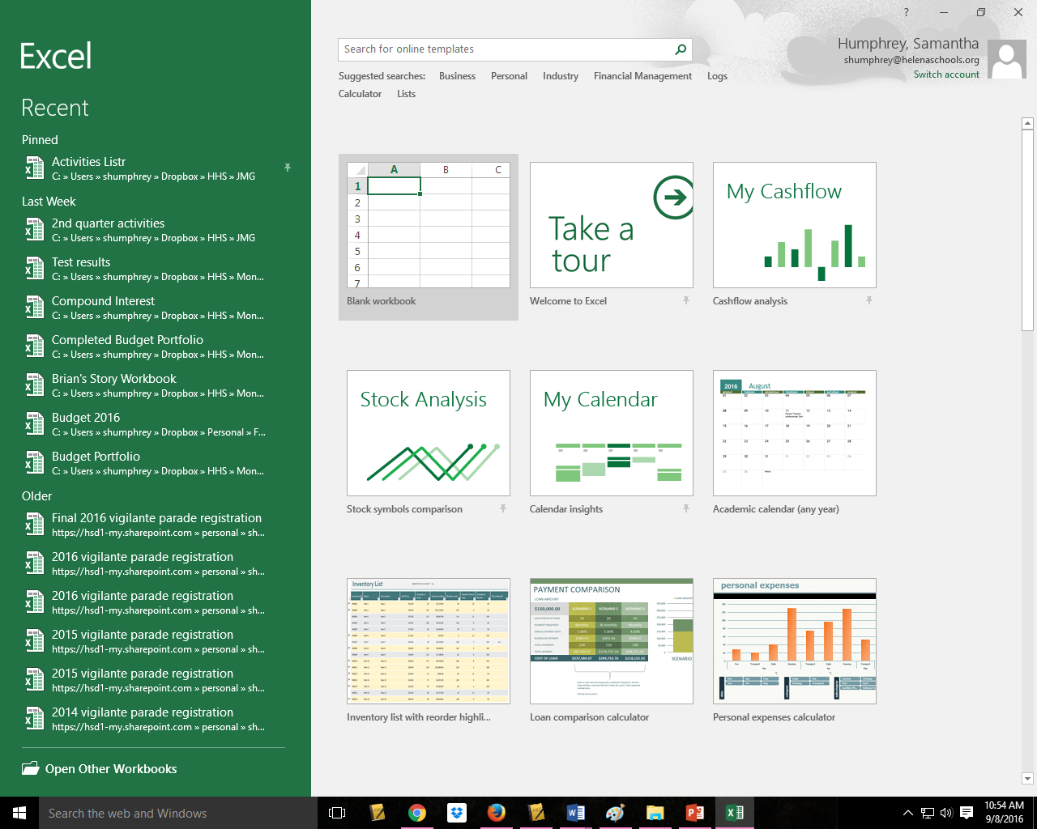
The Basics
To Open Excel 2016 in Windows 10 –
Click on the Windows Icon and open.
Click on “NEW” or search for a Template

Slide 3
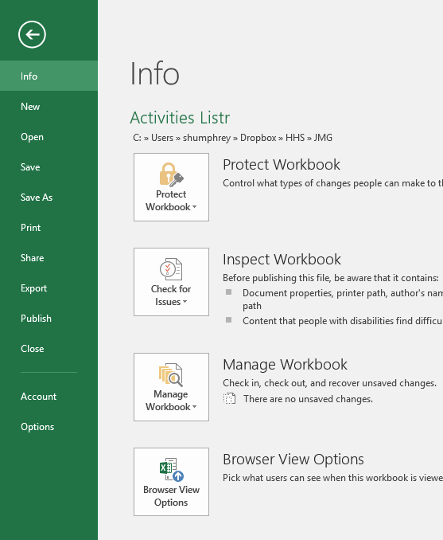
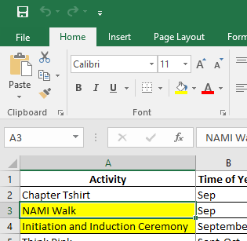
To Save
  If it is a new Workbook
    Go to the File TAB and always use Save As so you can name the file.
  If it is a Workbook you have just made changes to
    Go to the File Tab and click on Save or Click on the Disk icon on the Quick Access Bar.

Slide 4
Understanding the layout
Try it! Open a blank Excel Workbook and create a worksheet that looks like the following slides.

Slide 6
This is a zoomed in version ABOVE columns A-D

Slide 7
This is a zoomed in version bottom right of the worksheet

Slide 8
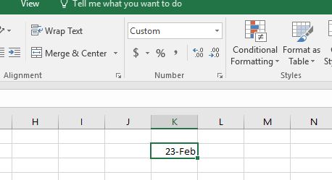

Lesson 2 – The Workbook
Entering text and labels is as easy as clicking in a cell and starting to type.
  The first character determines what the entry is – numeric, text, or formula
    Sometimes thought you have to select the cell and use the Number Group to change the automatic selection.
    For example: When you type in Feb 23 – not meaning it as a date, Excel automatically decides it looks like a date and changes it to a Custom entry as seen below. If I change the selector to say Text – Excel will change it back.

Slide 9
Understanding the layout
Try it! Open a blank Excel Workbook and type in a Feb 23 yourself.
Select the cell and in the number group change the selector to “Text.”
Now try it again putting in dates, numbers and use the selector in the Number group to change the selection.

Slide 10
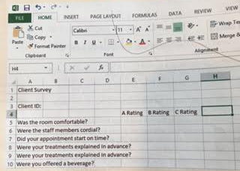
More Try it!!
Enter
This
In a
New
Worksheet and save it on your One Drive

Slide 11
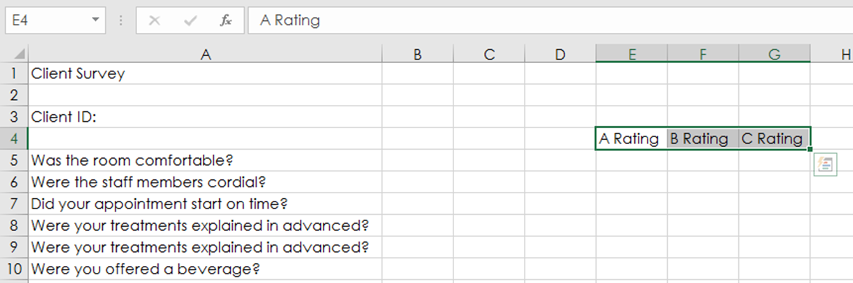
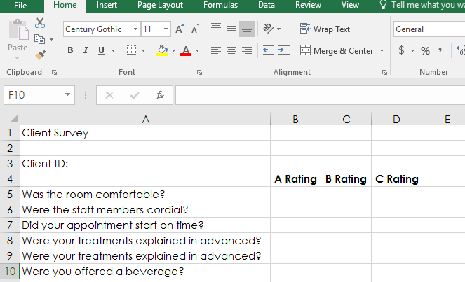
Step 1: Make your4 questions fit into one column by double clicking in between the A and B in the column header row. You will notice that your rating columns are 3 columns over.
Step 2: Select E4, F4 and G4. Release the mouse and hover over the bottom until you get a 4 way arrow. Drag the three heading to start in B4
Step 3: Bold and Center each of the headings

Slide 12
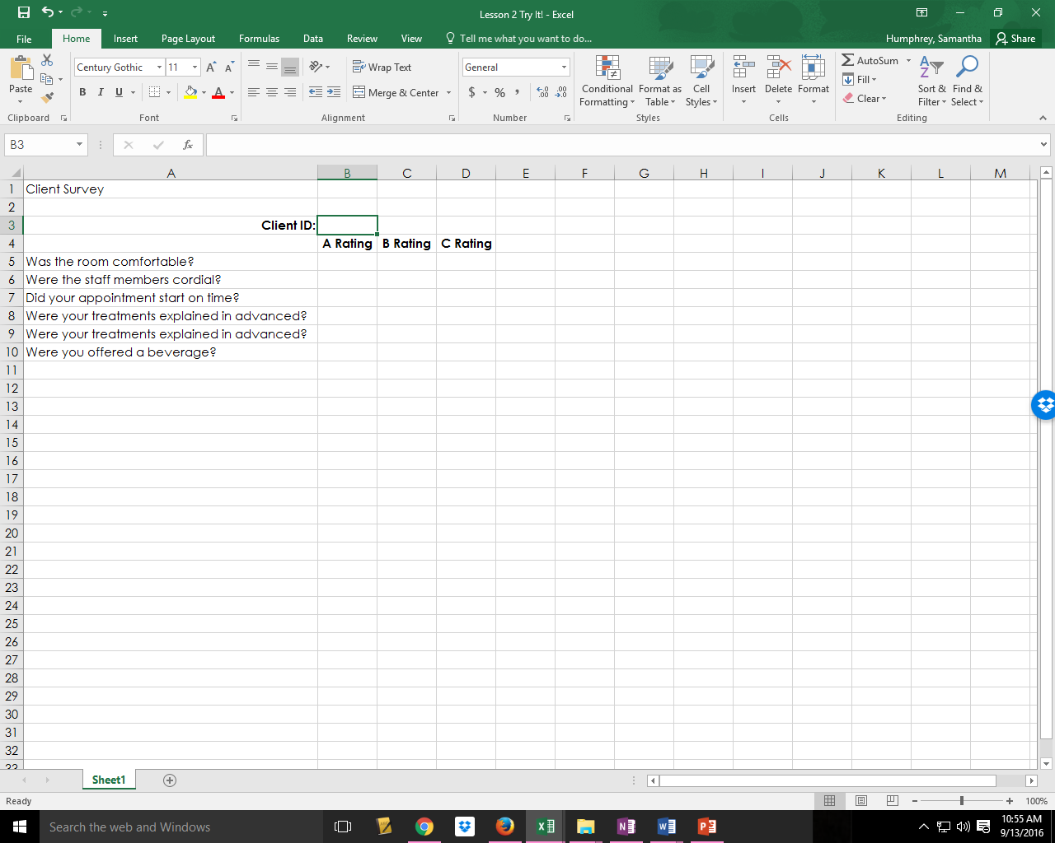
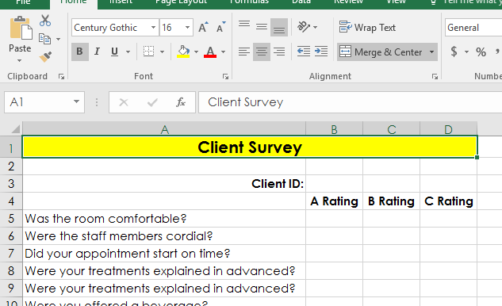
Step 4: Click on Client ID and format it so it is right justified and Bold.
Step 5: Select A1, B1, C1 and D1 – Release the mouse, click on Merge and Center
Step 6: Change the font to size 16, make it bold and fill with yellow.
Step 7: Change the text in Row 9 to Say: Were you relaxed during the process?

Slide 13
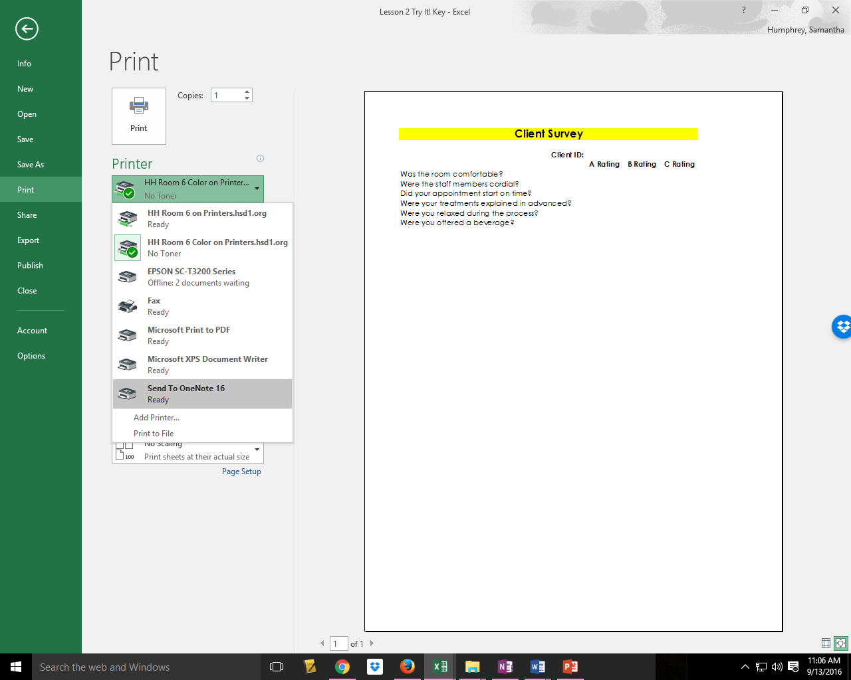
Step 8: Print to One Note 16 and put it in Completed Pages
Step 9: Change the Name from Printout to EO2

Slide 14
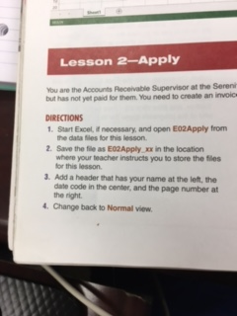
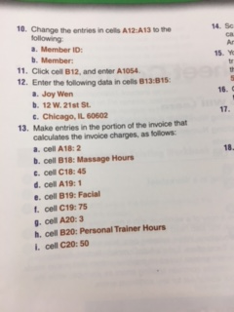
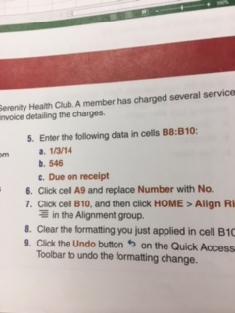
Apply it!
14. Save this by Printing it to your OneNote 2016 and then rename it EO2 Apply

Slide 15
Lesson 3 – Adding Data
Sometime you use a spreadsheet – enter information and then need to save it under a different name or you want to change the name.
IF you have added or changed data – just do a “Save As” and then rename it – your original spreadsheet is still available for use.
To rename a spreadsheet – open the file it is saved in – Right Click on the spreadsheet you wish to rename – Click on rename and then give it a new name. Your original spreadsheet will not be available since the name has changed.
Entering Data – this is pretty simple in terms of selecting a cell and adding what you want. Let’s try it by opening EO3Try and turning to pages 364-367 in the book.
Now complete the Apply It on page 369.

Slide 16
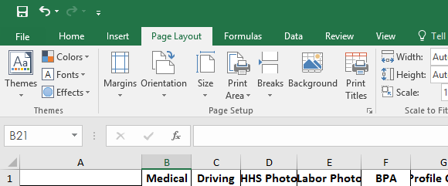
Lesson 4 – Formatting A Worksheet
Using Themes is an easy way to format a worksheet.
  Themes come in a variety or options however it is important not to use numerous themes because your worksheet will be hard to read and look unprofessional. Generally picking one theme is best.
  Fonts – both type of font, size, color and other attributes like Bold or Italics, can also be changed to add emphasis or to make the worksheet more interesting or understandable. However, when you select a theme the font will change as well.
  To use a Theme you select the theme you want on the Page Layout Tab.
Let’s try it now. Open EO4 and try the activities shown in page 372-377.
The complete the Apply It on 379.

Slide 17
Lesson 4 – Formatting A Worksheet
Using Themes is an easy way to format a worksheet.
  Themes come in a variety or options however it is important not to use numerous themes because your worksheet will be hard to read and look unprofessional. Generally picking one theme is best.
  Fonts – both type of font, size, color and other attributes like Bold or Italics, can also be changed to add emphasis or to make the worksheet more interesting or understandable. However, when you select a theme the font will change as well.
  To use a Theme you select the theme you want on the Page Layout Tab.

