Slide 1
Python
A little more understanding

Slide 2
What is Python
Python is a high-level, interpreted, interactive and object oriented-scripting language.
Python is Interpreted
Python is Interactive
Python is Object-Oriented
Python is Beginner's Language

Slide 3
Uses of Python
Web and Internet Development
Python offers many choices for web development:
Frameworks such as Django and Pyramid.
Micro-frameworks such as Flask and Bottle.
Advanced content management systems such as Plone and django CMS.
Python's standard library supports many Internet protocols:
HTML and XML
JSON
E-mail processing.
Support for FTP, IMAP, and other Internet protocols.
Easy-to-use socket interface.

Slide 4
Uses of Python
Education
Python is a superb language for teaching programming, both at the introductory level and in more advanced courses.
Books such as How to Think Like a Computer Scientist, Python Programming: An Introduction to Computer Science, and Practical Programming.
The Education Special Interest Group is a good place to discuss teaching issues.
Desktop GUIs
The Tk GUI library is included with most binary distributions of Python.
Some toolkits that are usable on several platforms are available separately:
wxWidgets
Kivy, for writing multitouch applications.

Slide 5
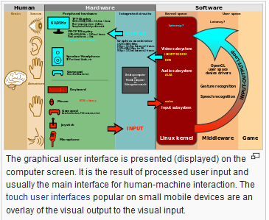
GUI – Graphical User Interface

Slide 6
Uses of Python
Software Development
Python is often used as a support language for software developers, for build control and management, testing, and in many other ways.
SCons for build control.
Buildbot and Apache Gump for automated continuous compilation and testing.
Roundup or Trac for bug tracking and project management.

Slide 7
Commands
Software Development
Python is often used as a support language for software developers, for build control and management, testing, and in many other ways.
SCons for build control.
Buildbot and Apache Gump for automated continuous compilation and testing.
Roundup or Trac for bug tracking and project management.

Slide 8
What is Turtle?
“Turtle” is a python feature like a drawing board, which lets you command a turtle to draw all over it!
The turtles are fun, but the real purpose of using them is to teach ourselves a little more Python, and to develop our theme of computational thinking, or thinking like a computer scientist.

Slide 9
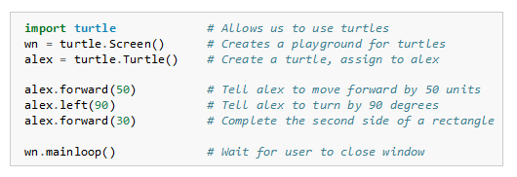
Getting Started with Turtles
Open your Apps
Select Python drop down and open Python Idle 3.5
You can then start working with Python command or Turtle commands
To use Turtle:
Page 2 of Learning with Python (Reading Assignment)

Slide 10
Getting Started with Turtles
You can use any name for your turtle as long as you tell python what to call it. So in the previous example – alex is the name (remember to type the name in lower case). We have used tom, tia, and turtle as names so it is up to you what you want to call it.

Slide 11
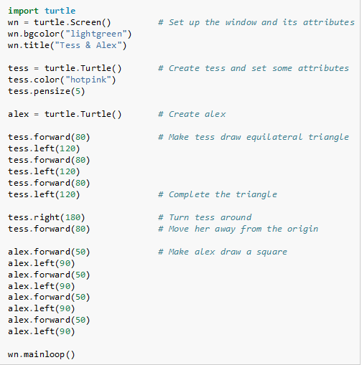
Getting Started with Turtles
You can even have more than one turtle. See this example from Page 2 in “Learning with Python”
Tess
Alex

Slide 12
Common Commands
penup() - picks pens up
pendown() - puts pen down
pencolor() - selects pen color
goto() - tells the turtle where to go
forward() - tells the turtle how far to go
left() - tells the turtle degree of left turn
right() -tells the turtle degree of left turn
setheading() – tells the turtle the direction to start
color() - selects fill color
bgcolor() – sets background color
shape() – changes the shape of the “turtle”
begin_fill() - tells the turtle to start filling
end_fill() - tells the turtle to stop filling
for i in range - loop

